Slide 1
Web Development
Introduction to the world of JavaScript

Slide 2
Let’s get started!

Slide 3
Express.js
Introduction to REST API

Slide 4
REST API
REST stands for REpresentational State Transfer
REST is an architectural style, or design pattern, for APIs (API: Application Programming Interface)

Slide 5
Important Definitions
Server: a computer or computer program which manages access to a centralized resource or service in a network.
Client: a person or software who uses the API.
Resource: can be any object the API can provide information about.
HTTP (Hypertext Transfer Protocol): Protocol for communication between servers

Slide 6
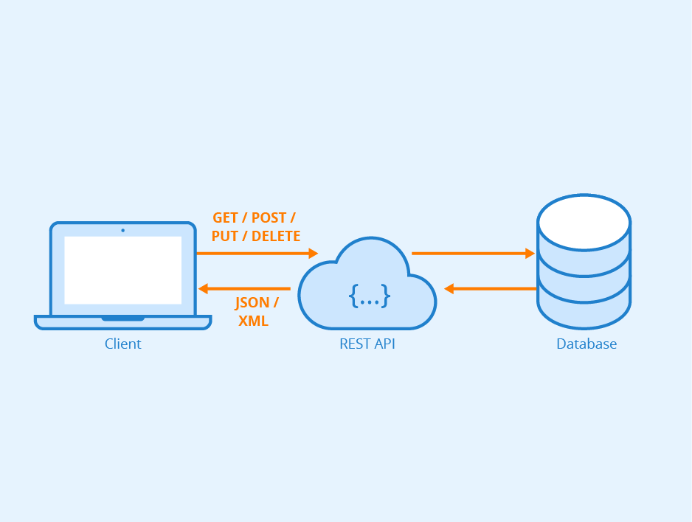
Key Idea
when a REST API is called, the server will transfer to the client a representation of the state of the requested resource.

Slide 7
Types of HTTP methods
GET - Retrieves resource from the server (should only retrieve resource and should have no other effect).
POST - This HTTP request type is usually used for creating an entity i.e. a resource without an id. Once the request is successfully created, an id of the newly created resource is returned as part of the response to this HTTP request.
PUT - Similar to POST, but used to update an existing resource. You pass the id of existing resource along with the request.
PATCH - Applies partial modifications to a resource.
DELETE - Removes the resource from the server. You need to pass the id of the resource to be deleted.

Slide 8
Let’s implement our first RESTful API endpoints

Slide 9
Review
We have learned about:
REST architecture
initialized our project
setup express.js
made our first REST API calls
Implemented GET, POST, DELETE routes for out project

Slide 10
See you next week!

Slide 11
Sources
https://medium.com/extend/what-is-rest-a-simple-explanation-for-beginners-part-1-introduction-b4a072f8740f
https://medium.com/@kumaraksi/using-http-methods-for-restful-services-e6671cf70d4d
https://expressjs.com/

